Slide 1

ENME480 Lab: Inverse Kinematics
Alex Beyer, Kaustubh Joshi

Slide 2
Todays Plan
Inverse Kinematics Intro Lecture
Time to work on FK Lab/IK Code

Slide 3
Announcements
Exam grades (hopefully) coming out soon, watch for an email telling you how to pick it up and ask for regrades!
Homework 3 grades hopefully coming shortly after
Lab group peer reviews are also coming after IK lab finishes
These will affect your grade!
Let us know either on Piazza or the peer review if you have a teammate who is not contributing.

Slide 4
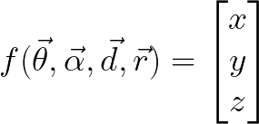
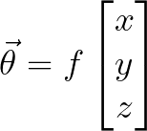
Recap & Motivation
Forward Kinematics lets us specify and end effector position by giving joint angles
The joint angles can be highly sensitive to changes in end effector position
If we want to design a function to move our end effector an inch to the right, how would do that via Forward Kinematics?
What if we needed to path the end effector around an obstacle? How would a physical object map into joint space? (hint: its usually unintuitive)

Slide 5
The Inverse Kinematic Problem
Given a robot with a desired end effector position p (and potentially orientation φ) and set of constraints f, solve for a set of joint states s which will move the end effector to the desired position, subject to the constraints.
(we’ll leave dealing with constraints for another time!)
What kind of problem are we doing here?

Slide 6
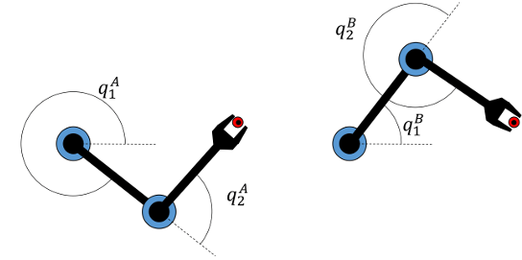
Issues
Imagine using your hand to pick up a block – is there only one valid way to bend your arm?
There are (in general) multiple solutions via IK for most points
Theres 2 for this robot, but how does this scale?

Slide 7
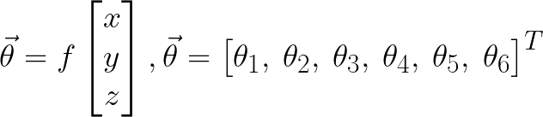
Issues
Outside a very particular set of systems (or set of constraints) we’re going to end up with an indeterminant system
No matter how we work this system we will not find a closed form solution without making major assumptions about how the robot moves!
Need to solve numerically!

Slide 8
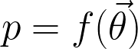
Solving the IK Problem - Cases
CASE I: An Analytical Solution Exists
Number of system DoF is low enough (or your assumptions are specific enough) to enable you to find a closed for equation of the form:
Rare this will happen
Requires robots/poses built in special ways
Just solve the equation
(easy-ish to solve so we gave you one for the project)
Notes:
Think analytic vs numeric!!!

Slide 9
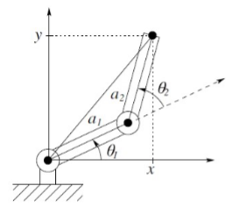
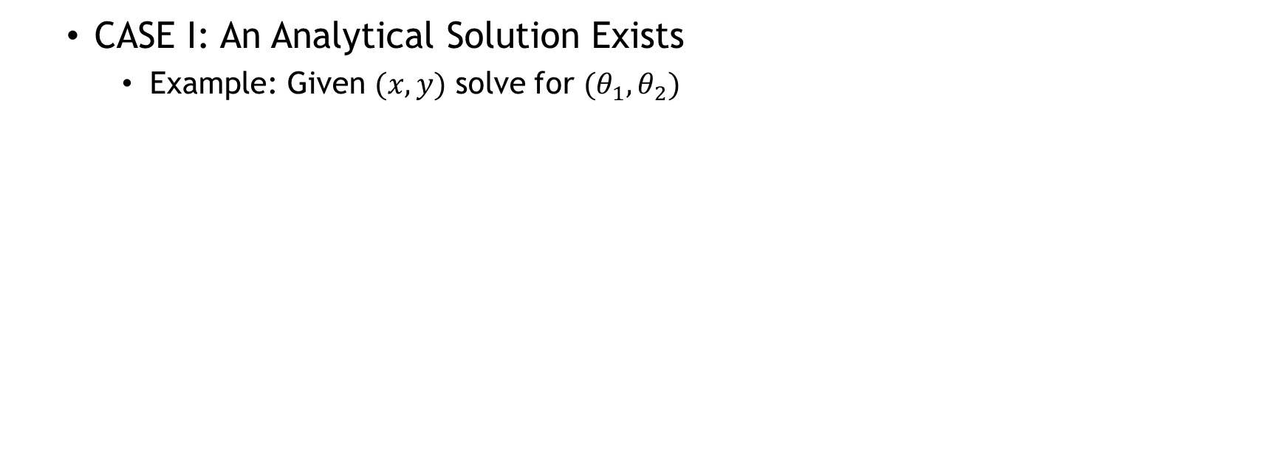
Solving the IK Problem - Cases
CASE I: An Analytical Solution Exists
Example: Given $(x,y)$ solve for $(θ_{1},θ_{2})$
Notes:
Think analytic vs numeric!!!

Slide 10
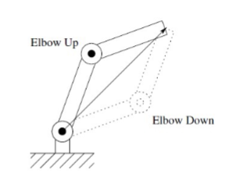
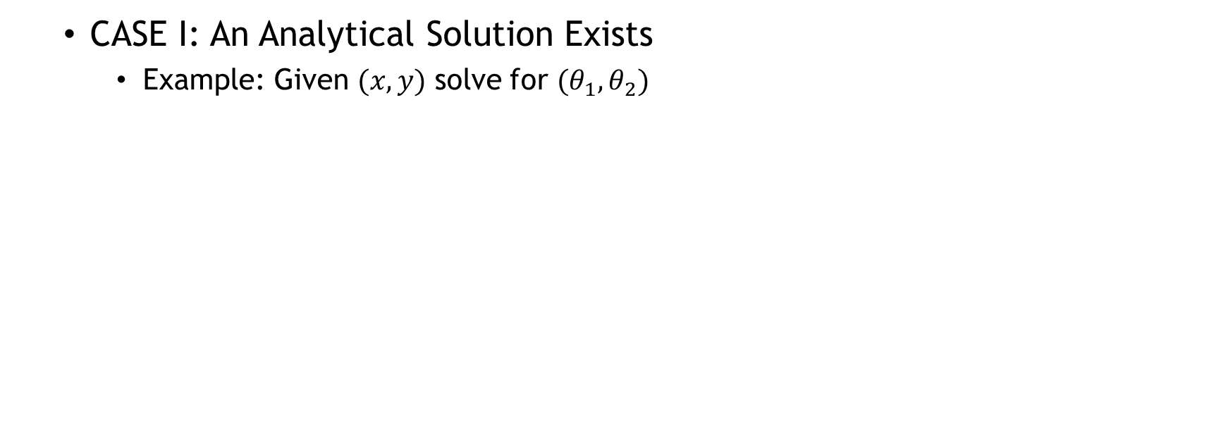
Solving the IK Problem - Cases
CASE I: An Analytical Solution Exists
Example: Given $(x,y)$ solve for $(θ_{1},θ_{2})$
Bent elbow → two solutions to IK
What do we do?
Pick one and use it as a constraint!
Notes:
Think analytic vs numeric!!!

Slide 11
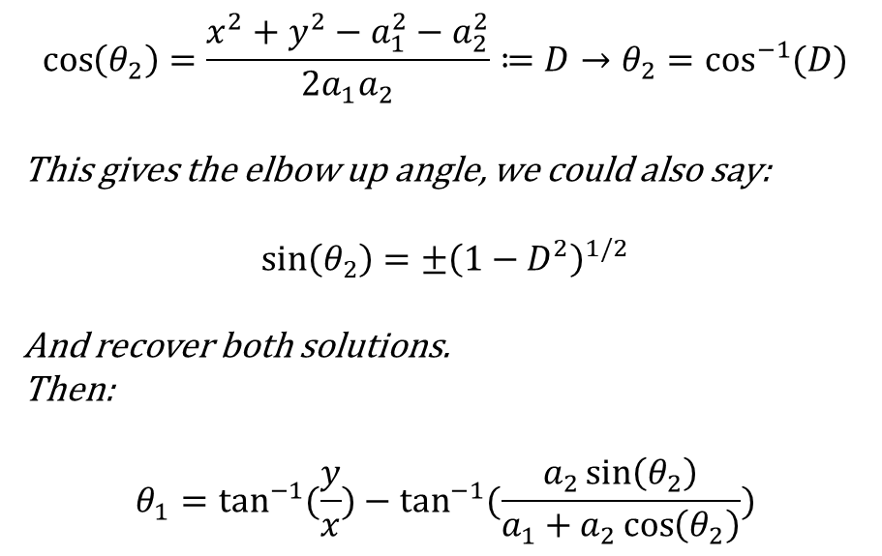
Solving the IK Problem - Cases
CASE I: An Analytical Solution Exists
Example: Given $(x,y)$ solve for $(θ_{1},θ_{2})$
$$\cos\left(θ_{2}\right)=\frac{x^{2}+y^{2}−a_{1}^{2}−a_{2}^{2}}{2a_{1}a_{2}}≔D→θ_{2}=\cos^{−1}{(D)}$$
This gives the elbow up angle, we could also say:
$$\sin\left(θ_{2}\right)=±{\left(1−D^{2}\right)}^{1/2}$$
And recover both solutions.
Then:
$$θ_{1}=\tan^{−1}{(\frac{y}{x})}−\tan^{−1}{(\frac{a_{2}\sin\left(θ_{2}\right)}{a_{1}+a_{2}\cos\left(θ_{2}\right)})}$$
Notes:
Think analytic vs numeric!!!

Slide 12
Solving the IK Problem - Cases
CASE 2: Most of An Analytical Solution Exists
The most common problem
How this is usually done in the real world
Combines techniques from the prior two cases
Interesting!
Results in us having to solve a highly nonlinear function numerically
Cyclic Coordinate Descent (CCD)
Notes:
Coordinate descent (along with its many, many variants) is the most common approach

Slide 13
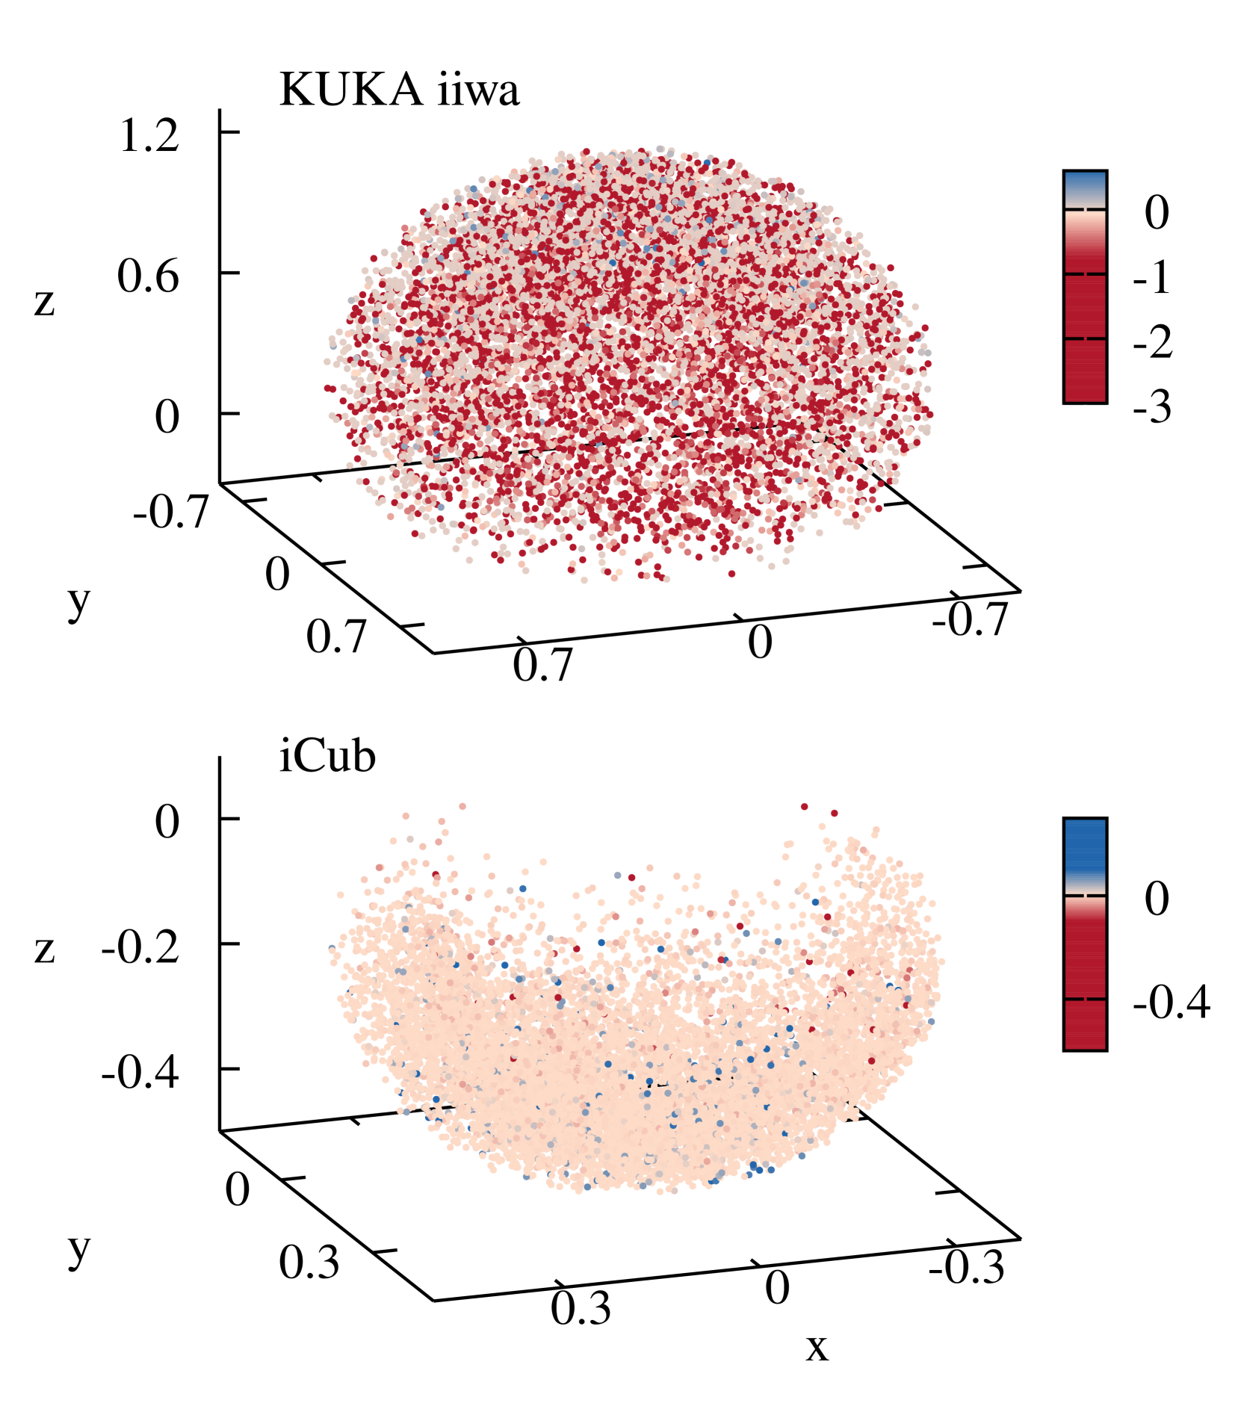
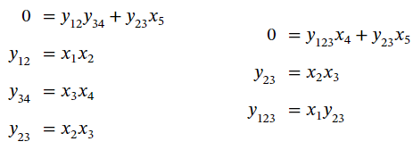
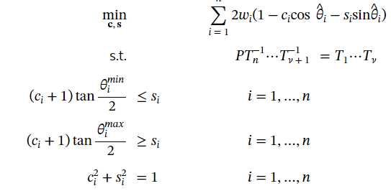
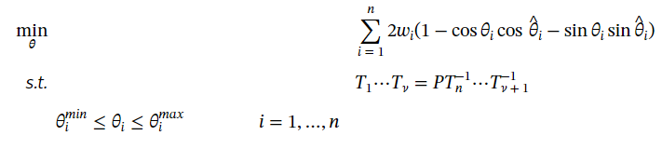
Solving the IK Problem - Cases
CASE 2: Most of An Analytical Solution Exists
Globally Optimal Inverse Kinematics as a Non-Convex Quadratically Constrained Quadratic Program,
Tomáš Votroubek and Tomáš Kroupa
Notes:
Coordinate descent (along with its many, many variants) is the most common approach

Slide 14

Solving the IK Problem - Cases
CASE 3: Most of An Analytical Solution Exists
Globally Optimal Inverse Kinematics as a Non-Convex Quadratically Constrained Quadratic Program,
Tomáš Votroubek and Tomáš Kroupa
Notes:
Coordinate descent (along with its many, many variants) is the most common approach

Slide 15
Solving the IK Problem - Cases
CASE 3: An Analytical Solution Does Not Exist
More common
Lack of assumptions makes it hard to say much
Results in us having to solve a highly nonlinear function numerically
Gradient Descent (GD)
Notes:
Coordinate descent (along with its many, many variants) is the most common approach

Slide 16
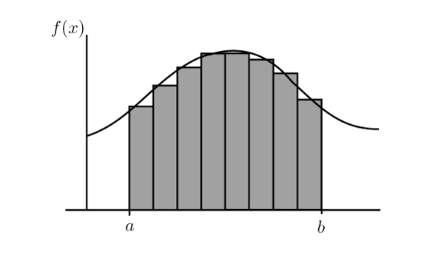
Numerical Methods
This is the barest bones version of the basics!
Instead of solving a large, complex equation outright break it into smaller, easier to solve steps and add those together!
Lowering the per step error ←→ Lowering the overall error
If you’ve ever used FEA Software (CAD) or an integrator in Python/MATLAB (ode45) this is what you’ve been doing!
Think of Riemann Integration

Slide 17
Implementation
Instead of thinking about the problem as “drive my end effector to a given position” let’s think about it as “how far away is my end effector from the final position?”
This is now an optimization problem
This is easier to optimize now, but we still don’t have a clear function to solve to get zero error
What should our next step be?

Slide 18
Implementation - Approach
Start with an initial guess for the state s_{i} and calculate its error
Generate another guess, offset by some amount and calculate its error
Think back to Calc 1, what can we say about optimality by doing this?
Use this to inform your next guess and check again
Remember to use your constraints to inform your next guess(es), they can narrow down the number of valid next guesses
Repeat this process until your error is below a threshold value

Slide 19
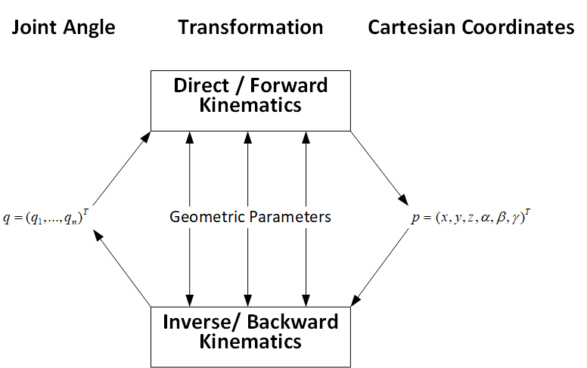
Implementation - Structure
Now we have a clearer understanding of our problem, but how do we find the error?
Forward Kinematics!
An estimate for the cartesian end effector which position will inform…
A guess for the robot angles which will inform…

Slide 20
Implementation - Issues
Forward Kinematics have the advantage of always working for a valid set of angles; not all valid points will work nicely in IK
Multiple sets of angles can correspond to one point, how do we pick?
Some singularities are purely mathematical; the math might say you’re stuck in a certain pose and can’t move but physically there’s nothing stopping you

Slide 21
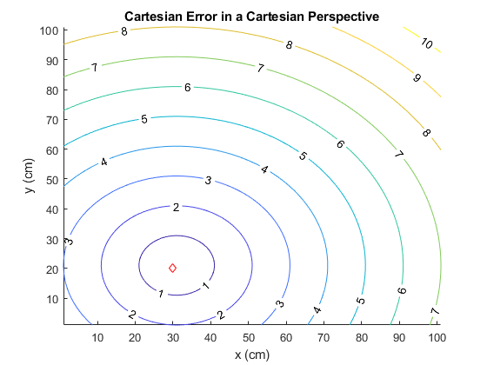
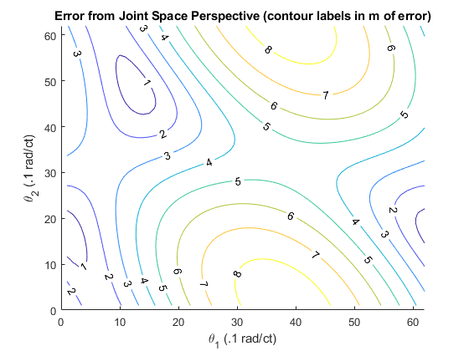
Implementation
We mentioned how moving in joint space is difficult, let’s revisit this concept: (desired point: <3,2>)
Notes:
Y=mx+b (technically affine) → solve for 0 → we’re finding this proportionality relationship btwn y and x then using it to backsolve in one step
This does not work for nonlinear systems

Slide 22
Descent Methods – Background
Potential Problems:
Motions in joint space aren’t clearly mapped to cartesian space
Local (but not global) minima
This 2 DoF planar case doesn’t have any, but higher DoF cases would
By extension, we are extremely sensitive to ICs
Need to calculate rate of change for a function we might not know
Numerical Derivatives
Stationary points
Added complexity → higher chance for the math to break down
Notes:
Think analytic vs numeric!!!

Slide 23
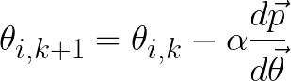
Descent Methods – Method
For end effector position p and joint state θ (both vectors):
Pick an initial condition
Set a desired precision and repeat:
Calculate dp/dθ
Pick a direction (randomly or otherwise)
Update your guess according to:
Update error, break if you’ve reached your desired precision
Notes:
Think analytic vs numeric!!!

Slide 24
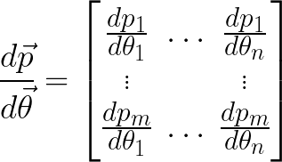
Descent Methods – Jacobians
Two problems when finding dp/dθ
First: Matrix Derivatives
What is the Jacobian telling you? What can we use this information for?
Yields an m by n Jacobian
The derivative of m states
With respect to n variables
Notes:
Think analytic vs numeric!!!

Slide 25
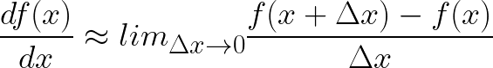
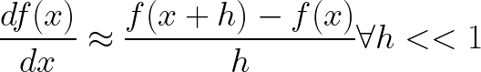
Descent Methods – Jacobians
Two problems when finding dp/dθ
Second: (Forward) Finite Differencing
We don’t have an analytical function to take a derivative, need to approximate
(this is the numerical methods part)
This is the central argument for all numerical derivatives and integrals
Notes:
Think analytic vs numeric!!!

Slide 26
Breaking Descent Methods
To understand how the method works, we also need to understand why it doesn’t
Think back to the list of issues before, which ones will we still face?
Notes:
Think analytic vs numeric!!!

Slide 27
Breaking Descent Methods
To understand how the method works, we also need to understand why it doesn’t
Think back to the list of issues before, which ones will we still face?
Sensitivity to ICs – fundamental to the method
Local Minima – also fundamental to the method
Stationary Points – we can design corrections for this
IK Singularities – needs investigating
Notes:
Think analytic vs numeric!!!

Slide 28
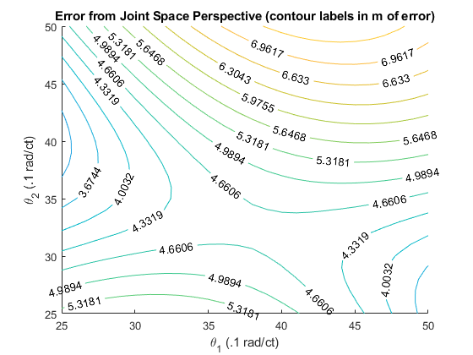
Breaking Descent Methods – Stationary Points
Stationary points in the error function behave like valid solutions (locally) with high error
How do we fix?
Perturb our guess for θ by Δθ in all directions, increasing the magnitude of Δθ if we fall back to the same point
This thought process broadly applies to local minima as well
Notes:
Think analytic vs numeric!!!

Slide 29
Breaking Descent Methods– Identifying Singularities
Two main types of singularity:
Boundary Singularities
Occur when hyperextending a joint, determined by the physical structure of the robot
Internal Singularities
Purely mathematical, typically caused by the joint axes aligning during a movement
Result in either an infinite number of solutions (we need some choice criteria) or result in math that, when worked out, requires infinite joint velocity/force
Ex: two axes aligning such that the motion in one perfectly cancels the motion in the other
Notes:
Solution space loses dimensions for internal singularities; equivalent to no longer having a unique solution to things
We can spot this via the Jacobian, but I’ll leave that for a later class that can spend multiple lectures building this idea (its incredibly powerful and I don’ want to misspeak)

Slide 30
Solving the IK Problem - Cases
These are not 3 unrelated methods; they share a lot of techniques and approaches
Think of it as a spectrum from fully numeric to fully analytic
Numeric Methods
Heuristic Methods
Analytic Methods
Notes:
Coordinate descent (along with its many, many variants) is the most common approach

Slide 31
Assignment Code - Structure
Download the lab4_scripts.zip file from Canvas
Only edit the lab4_func.py file!
Copy and paste your working Lab 3 code into lab4_func.py in the designated space, you’ll use this to verify your guesses
We’ve given you a skeleton outline for what order you should find things in

Slide 32
Assignment Code - Constraints
The UR3e robot is a 6 DoF robot meaning we need to solve for 6 configuration variables
We added the constraint that we want joint 5 (the 2nd wrist joint) to always be –π/2, pointing straight down
Now we’re down to 5 DoF
Additionally, we’re passing in a desired yaw value
No reduction in DoF, but we do get another equation to use (4 variables in 5 equations)
Finally, we specify the “elbow up” configuration
This doesn’t become an equation, but it does give us a rule to discard solutions

Slide 33
Final Notes
FK Lab due Friday!
UR3e DH table posted to the wiki
IK lab due in 2 weeks

Slide 34
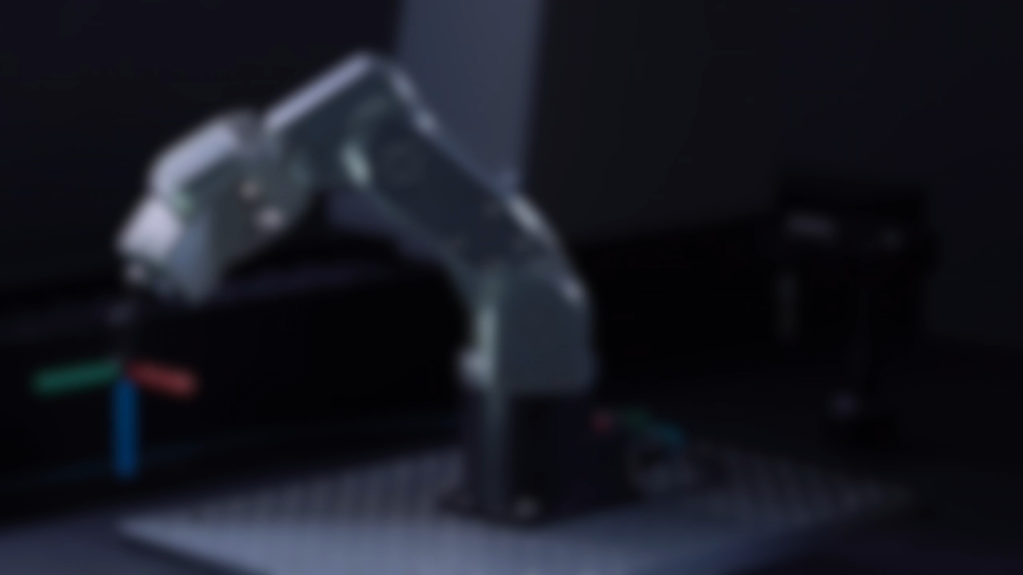
Notes:
Solution space loses dimensions for internal singularities; equivalent to no longer having a unique solution to things
We can spot this via the Jacobian, but I’ll leave that for a later class that can spend multiple lectures building this idea (its incredibly powerful and I don’ want to misspeak)

Slide 35
Notes on DH Parameters
Joint {i}
Frame {i}
Any transform (T^{i-1}_{i}, for example) is made of four operations:
Offset a distance d_{i} along z_{i-1} to the common normal of frames {i-1} and {i}
If no common normal exists, pick a convenient value for d_{i}
Rotate x_{i-1} by θ_{i} to align it with x_{i}
Translate a distance a_{i} along the common normal, from x_{i-1} to x_{i}
Finally, rotate by an angle α_{i} about x_{i} to align z_{i}
Frame {i-1}
Joint {i+1}

Slide 36
Notes on DH Parameters
Joint {i}
Frame {i}
There are pointers for how to align your axes to make this easier:
The x_{n} axis must intersect and be perpendicular to z_{n} and z_{n-1}
The origin of the nth joint lies at the intersection of x_{n} and z_{n}
y_{n} is any valid axis that completes a right handed frame
Remember the right hand rule when finding angles!
Frame {i-1}
Joint {i+1}

Slide 37
Motivation
In the process of doing Forward Kinematics we derived a set of equations for our geometry as a function of our DoFs
We know that we have some workspace in cartesian space where the end effector can reach
Trying to navigate joint space to move around the workspace is unintuitive and confusing (what does a unit change in a joint angle do to the end effector?)
What if we want to find joint angles corresponding to an end effector position?

Slide 38
Motivation
Approaches based in FK are fundamentally limited, but give a useful set of equations from the geometry:
What if we ran these equations in reverse?
Can you see the problem?

